Slide 1
Snort
Intrusion Detection System

Slide 2

IDS Configurations
Configured setting to network ip 10.0.2.15 enp0s3
Can be changed with command sudo dpkg –reconfigure snort

Slide 3
Rule Tuning
Generated rules under local rules
GitHub
FTP
Ping
Nmap scanning
SSH
DOS attack

Slide 4
Attack simulations
Nmap scanning
Ping
SSH scanning
FTP attempt
DOS attack
Internet alert

Slide 5

Logging
Logging event in log file under home after each attempt
Sudo snort –c –l /home/log/ snort.conf –A console –I enp0s3
Snort –de – l /home/log/
Open logs in Wireshark for analysis

Slide 6
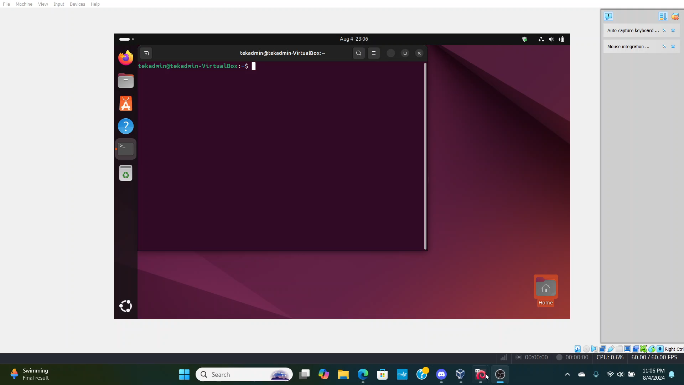
Project Video

